Slide 1
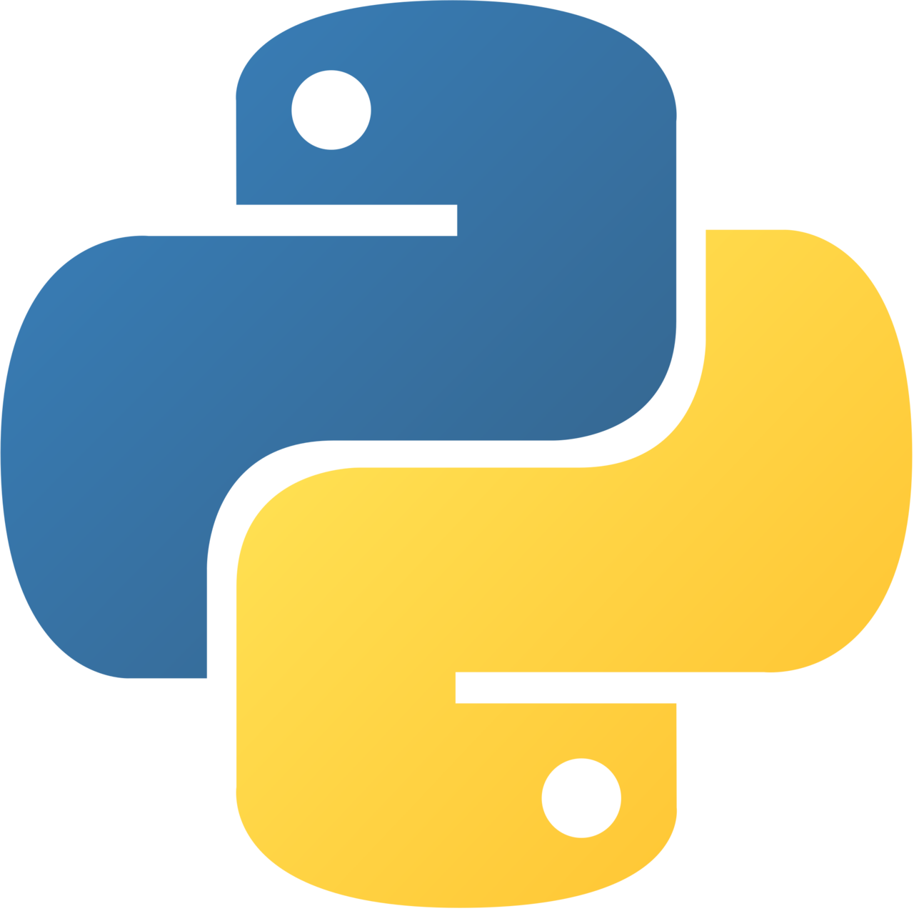
Python Presentation
- max(), min(), index(), len() and count()
Pratyush Majumdar

Slide 2
Topics covered
01
02
03
04
05
max()
min()
index()
len()
count()

Slide 3
1) max()
The max() function returns the item with the highest value, or the item with the highest value in an iterable.
If the values are strings, an alphabetically comparison is done.
If multiple items are maximal, the function returns the first one encountered.
Syntax: max(n1, n2, n3, …) or max(iterable)

Slide 4
2) min()
The min() function returns the item with the lowest value, or the item with the lowest value in an iterable.
If the values are strings, an alphabetically comparison is done.
If multiple items are minimal, the function returns the first one encountered.
Syntax: min(n1, n2, n3, …) or min(iterable)

Slide 5
3) index()
The index() method searches for a given element from the start of the list and returns the position of the first occurrence.
It raises a ValueError() if value is not present in the list.
Syntax: list_name.index(element, start, end)

Slide 6
4) len()
The len() function returns the number of items in an object.
The argument may be a sequence (such as a string, bytes, tuple, list, or range) or a collection (such as a dictionary, set, or frozen set).
When the object is a string, the len() function returns the number of characters in the string.
Syntax: len(object)

Slide 7
5) count()
The count() method returns the number of elements with the specified value.
It only accepts one parameter, if you pass more than one parameter it raises TypeError.
Syntax: list_name.count(value)

